Slide 1
Setup Windows 7

Slide 2
Windows 7: System Requirements
If you want to run Windows 7 on your PC, here's what it takes:
1 gigahertz (GHz) or faster 32-bit (x86) or 64-bit (x64) processor
1 gigabyte (GB) RAM (32-bit) or 2 GB RAM (64-bit)
16 GB available hard disk space (32-bit) or 20 GB (64-bit)
DirectX 9 graphics device with WDDM 1.0 or higher driver
Additional requirements to use certain features:
Internet access (fees may apply)
Depending on resolution, video playback may require additional memory and advanced graphics hardware
For some Windows Media Center functionality a TV tuner and additional hardware may be required
Windows Touch and Tablet PCs require specific hardware
HomeGroup requires a network and PCs running Windows 7
DVD/CD authoring requires a compatible optical drive
BitLocker requires Trusted Platform Module (TPM) 1.2
BitLocker To Go requires a USB flash drive
Windows XP Mode requires an additional 1 GB of RAM, an additional 15 GB of available hard disk space, and a processor capable of hardware virtualization with Intel VT or AMD-V turned on
Music and sound require audio output

Slide 3
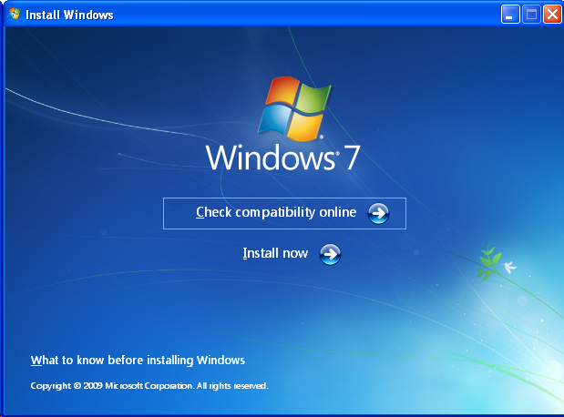
This Is Auto Run Window
Click “Install” now For Setup windows 7

Slide 4
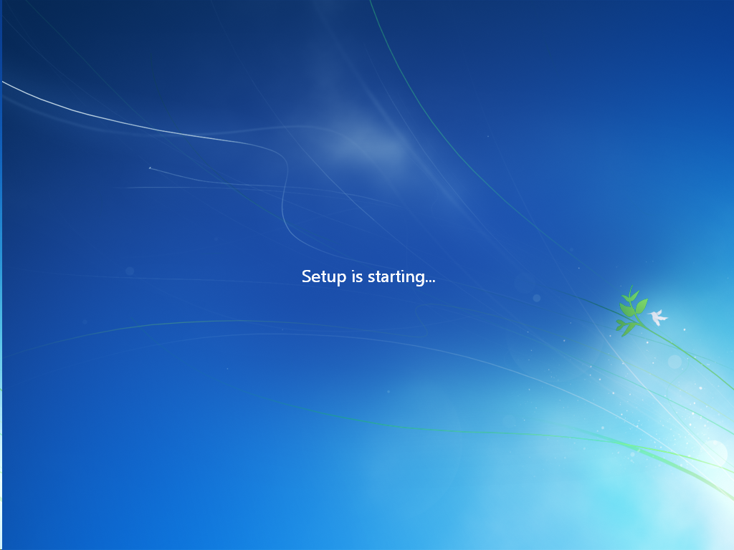
Setup Is Loading
|||||||||||||||||||||||||||||||||||||||||||||||||||||||||||||||||||||
Wait few Minutes

Slide 5
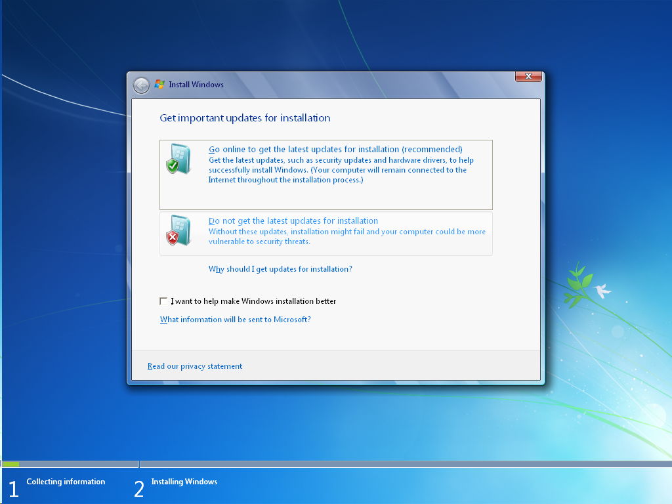
Click “do Not Get the Latest update

Slide 6
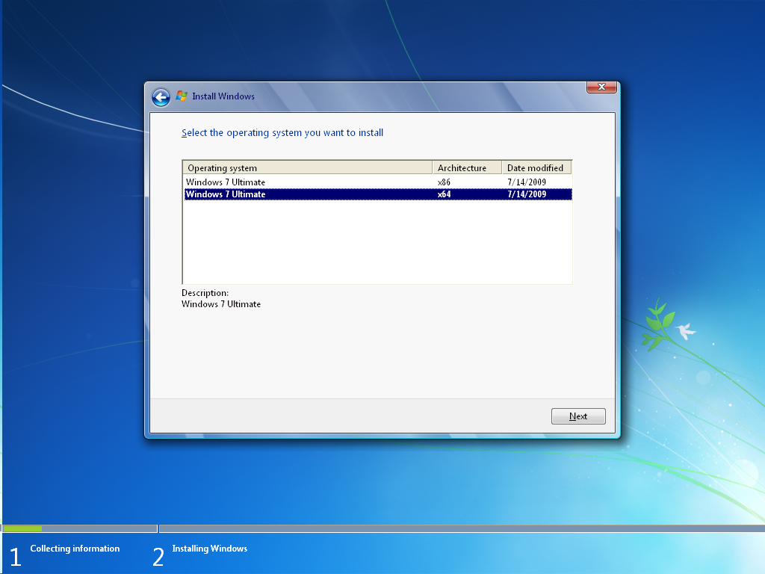
Choose 32Bit/64Bit For Installation

Slide 7
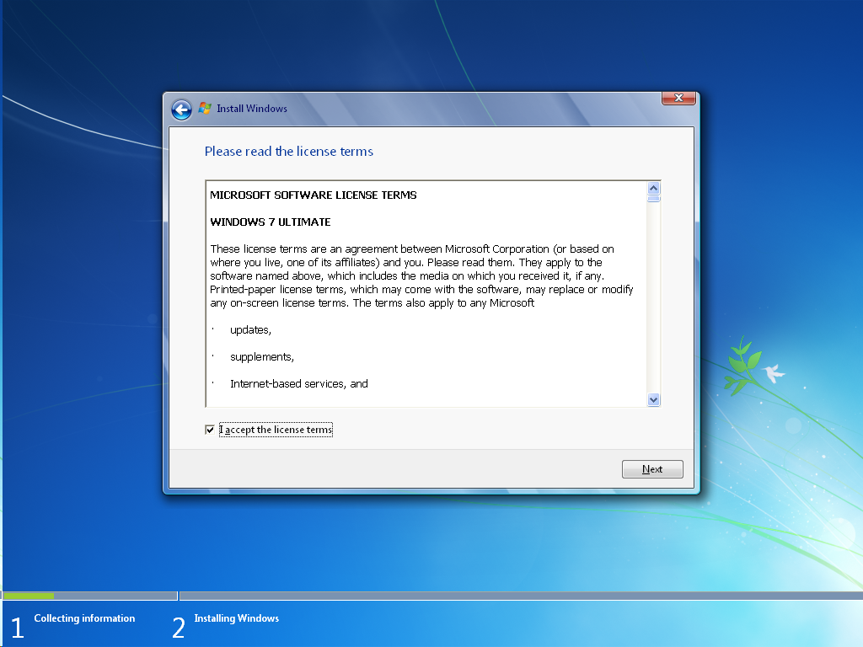
Read & accept license terms

Slide 8
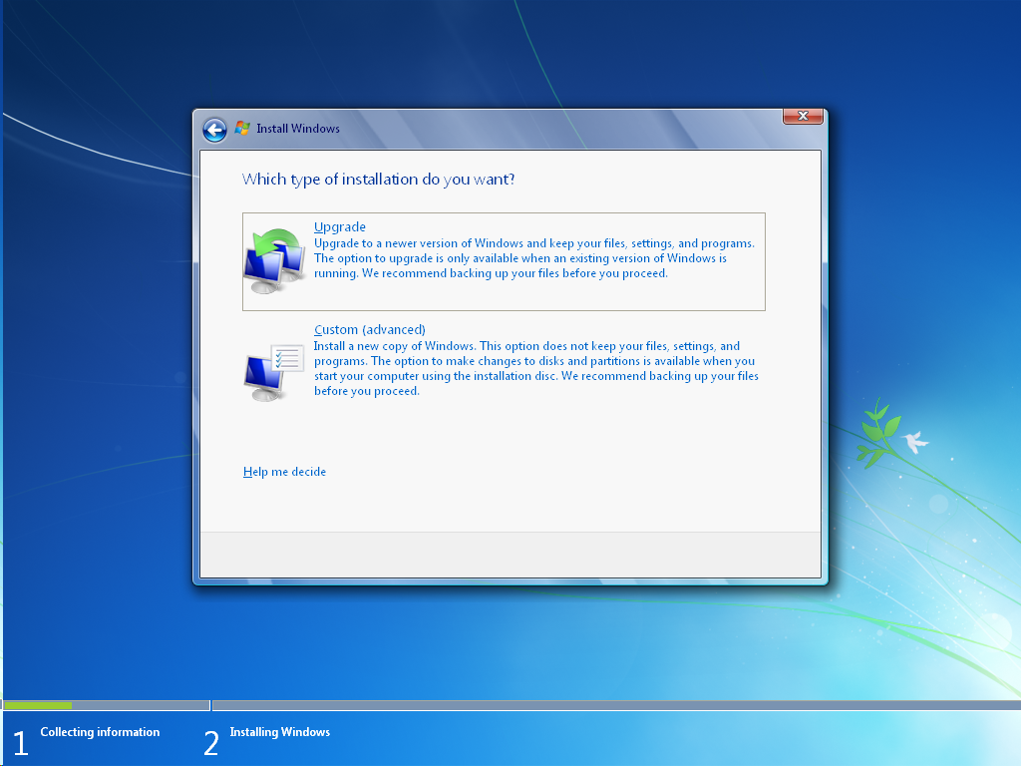
Click “custom” For install clean of windows

Slide 9
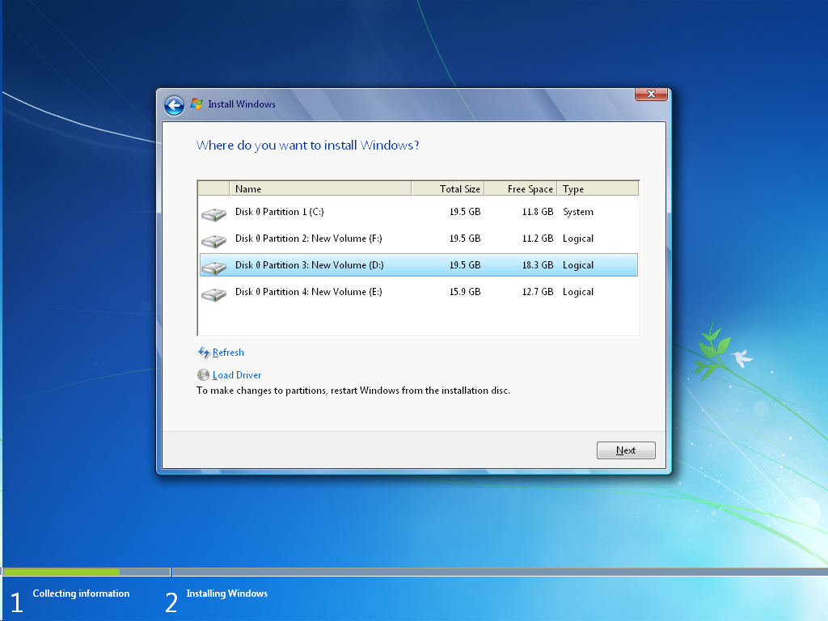
Select Installation partition

Slide 10
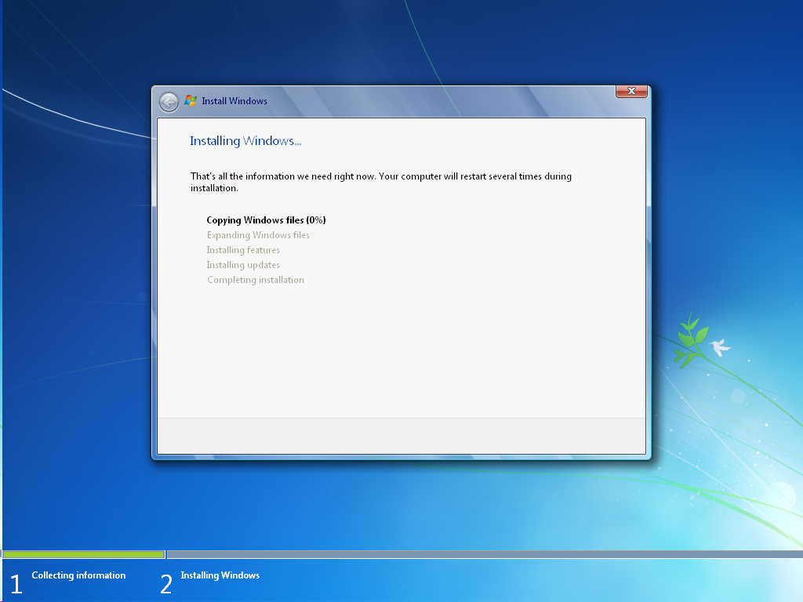
Start copying setup Files
||||||||||||||||||||||||||||||||||||||||||||||||||||||||||||||||||||||||||||||||||||||||||||||||||||||||||||||||||

