Slide 1
Setup windows 2003 server
(standard edition.)

Slide 2
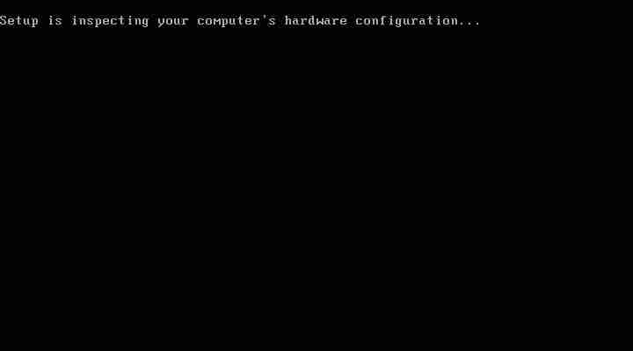
Start the computer from the CD.

Slide 3
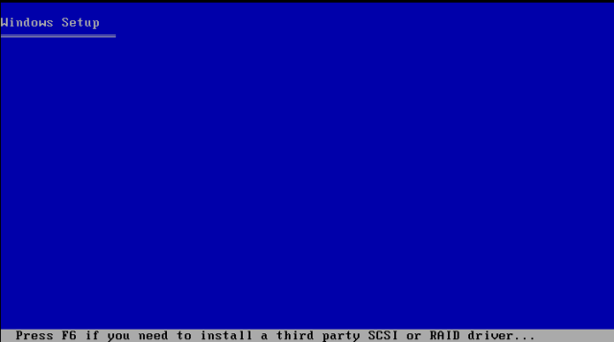
You can press F6 if you need to install additional SCSI adapters or other mass-storage devices.

Slide 4
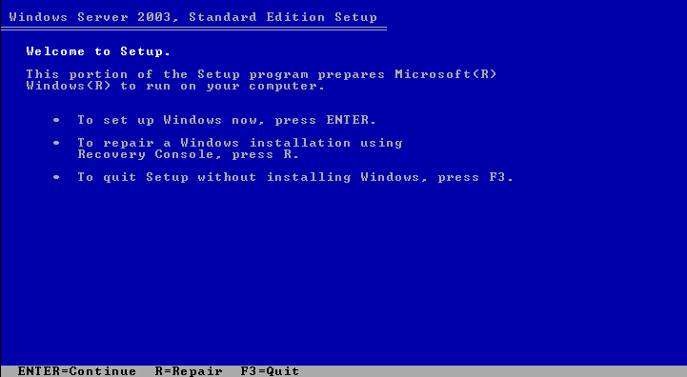
now you are in the welcome setup Windows 2003 standard edition. To set up windows, press <enter>.

Slide 5
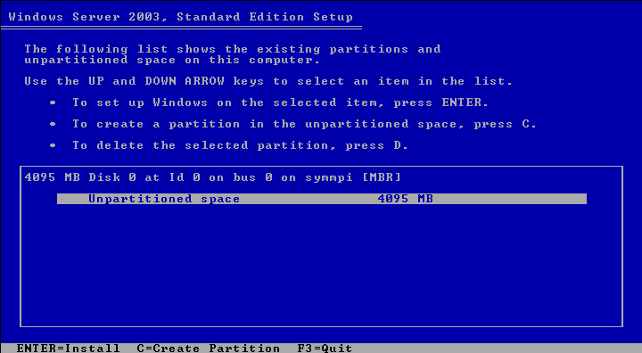
To create a partition in the unpartitioned space, press C.
To create a partition in the unpartitioned space, press C.

Slide 6
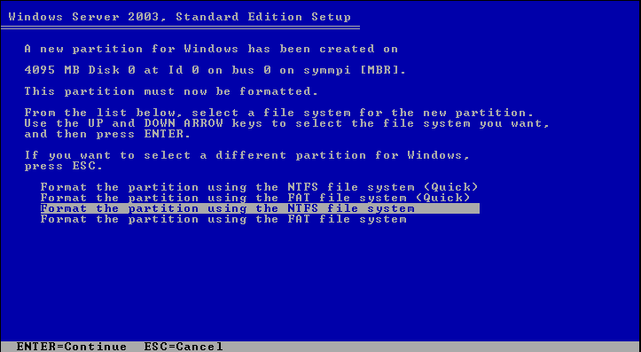
Format the partition using the NTFS file system. Press <enter> to continue.
Format the partition using the NTFS file system. Press <enter> to continue.

Slide 7
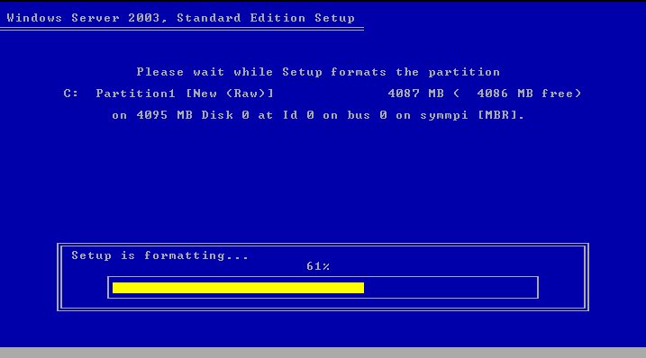
Setup is formatting. Just wait! ;-).
Setup is formatting. Just wait! ;-).

Slide 8
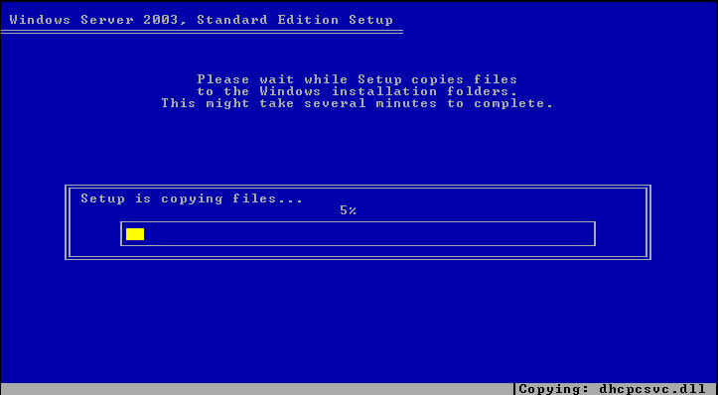
Setup is copying files. Please wait, this might take several minutes to complete.

Slide 9
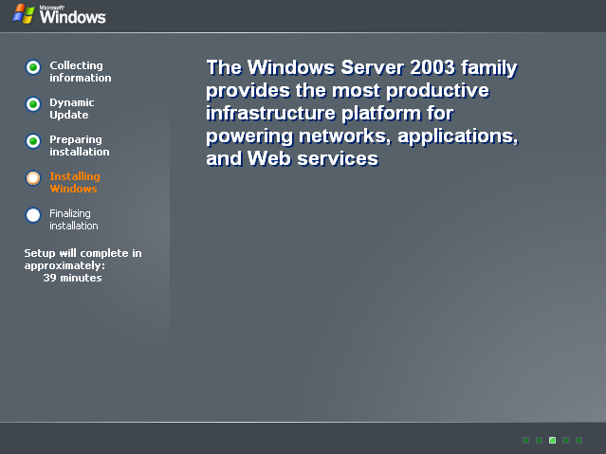
Now, installing windows in progress. Setup will complete in approximately minutes. Please wait ;-).
Now, installing windows in progress. Setup will complete in approximately minutes. Please wait ;-).

Slide 10
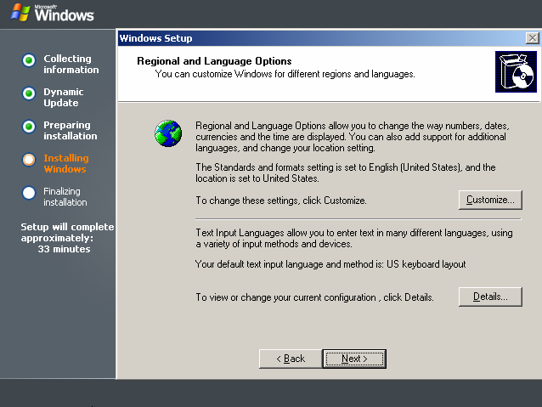
Click next to continue setup.

Slide 11
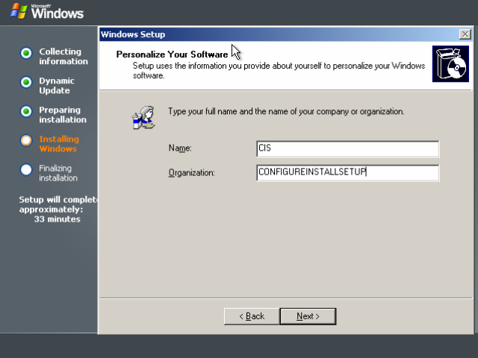
Type your full name and the name of your company or organization. Click next button to continue setup.

Slide 12
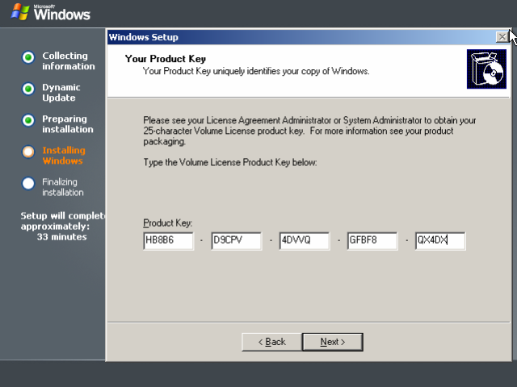
Type the Volume License Product Key below. Make sure you put the correct product key

Slide 13
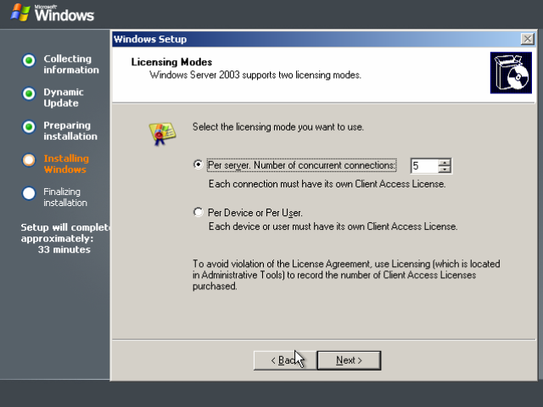
You can select the licensing mode you want to use. After you decide click next to proceed.
You can select the licensing mode you want to use. After you decide click next to proceed.

Slide 14
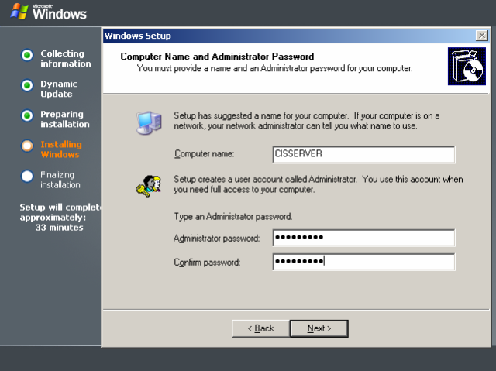
Please put your computer name and type an administrator password. Click next to proceed.

Slide 15
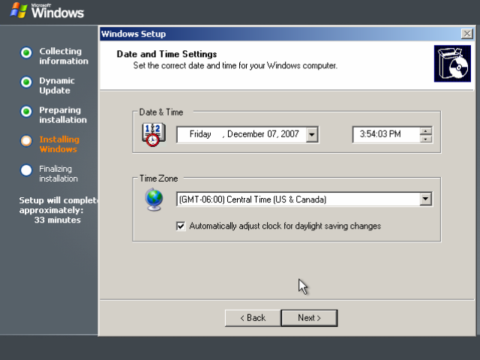
Set the correct date and time for your Windows computer and click next to continue.

Slide 16
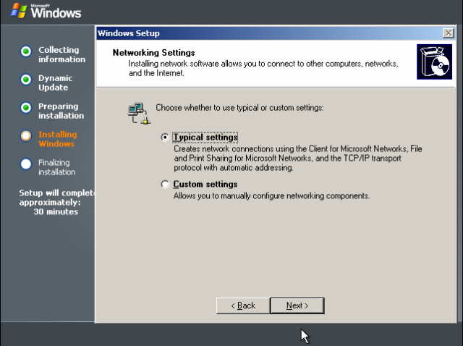
Select typical setting on the networking settings, then click next button to continue.
Select typical setting on the networking settings, then click next button to continue.

Slide 17
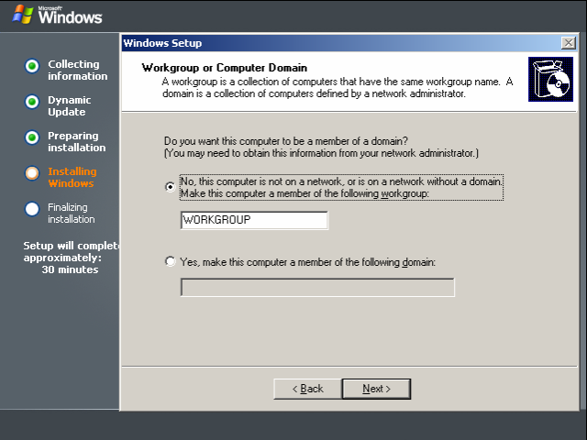
Use the default workgroup that have been given by windows. You can change if you want, it’s doesn't matter. Click next to continue.

Slide 18
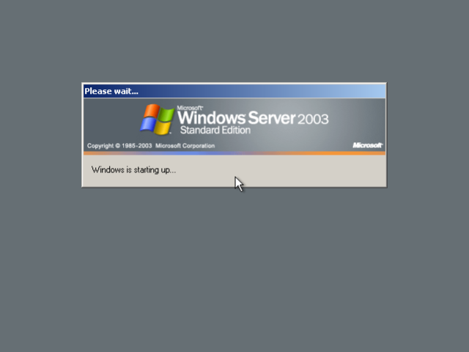
The windows is starting up.

Slide 19
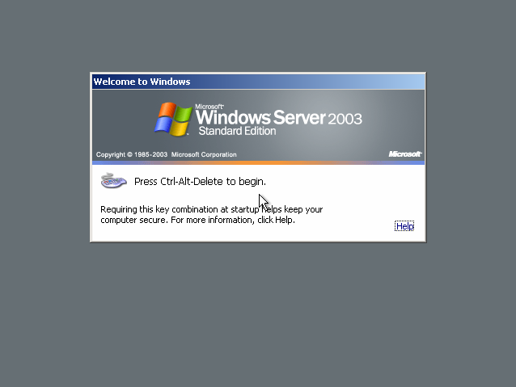
Welcome to Windows Server 2003 Standard Edition Login page.

Slide 20
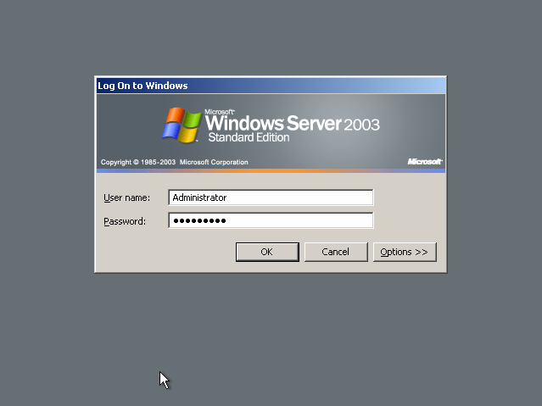
After press ctl+alt+del, please put your username as administrator and password, then click ok.
After press ctl+alt+del, please put your username as administrator and password, then click ok.

Slide 21
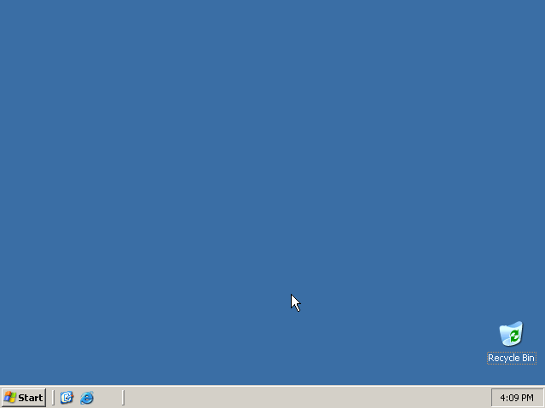
successfully installed windows 2003 server standard edition.

