Slide 1
Installing UBUNTU

Slide 2
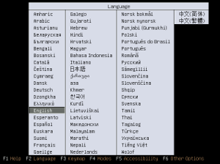
Now that you have the Desktop CD, you'll need to reboot your computer to use Ubuntu.
Your computer's BIOS must be set to boot from CD first; otherwise, Windows will just load up again. To get into the BIOS settings, you usually have to press one of these keys during boot-up: Escape, F1, F2, F12, or Delete. Usually your computer will tell you which key to use.

Slide 3
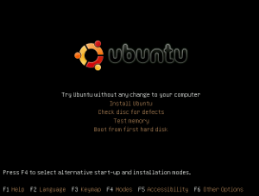
Once your BIOS is configured to boot from CD first, if you have Ubuntu in the drive, you should see this screen. Select your language.

Slide 4

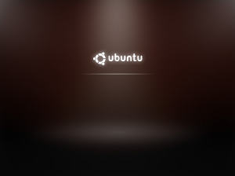
After that, you should see a progress bar as the CD prepares to launch the installer.
Wait few Minutes

Slide 5
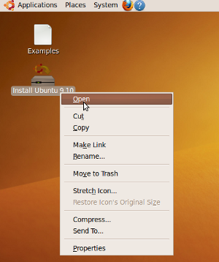
Click the Install on the desktop to begin the installation

Slide 6
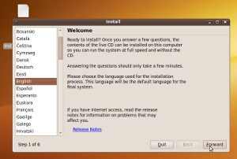
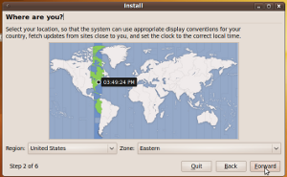
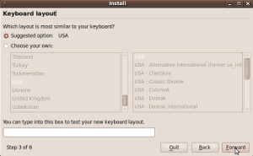
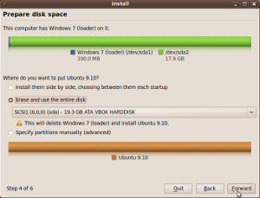
Answer the questions as best you can. Most of them should be self-explanatory.

Slide 7
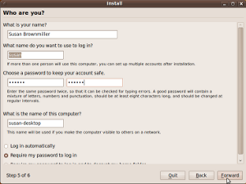
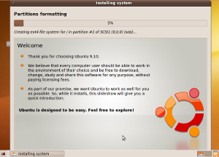
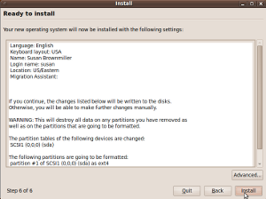
If you are concerned about ever having to reinstall Ubuntu, but you want to make sure your user settings and files are preserved, check out these details on creating a separate /home partition during this part of the installation.

Slide 8
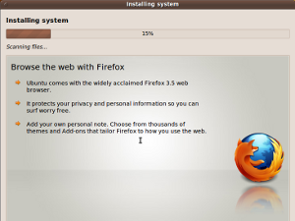
Wait few Minutes

Slide 9
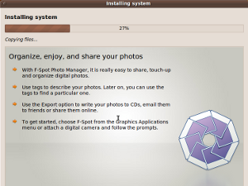
Wait few Minutes

Slide 10
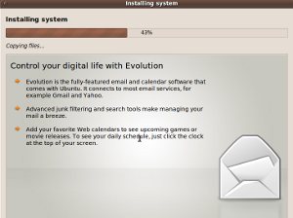
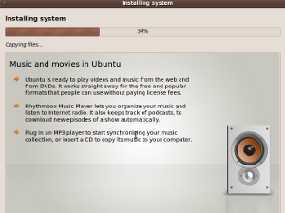
Wait few Minutes

Slide 11
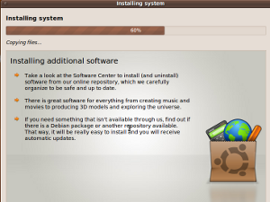
Wait few Minutes

Slide 12
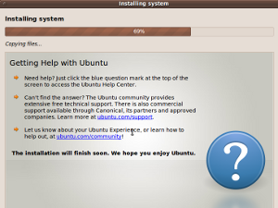
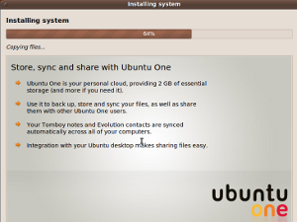
Wait few Minutes

Slide 13
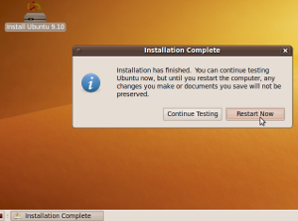
After the installation is done, you have the option to keep using your live session of Ubuntu or to reboot and start using the installed version of Ubuntu.

Slide 14
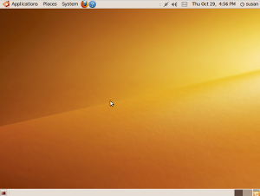
After you reboot, don't be alarmed if you see some text boot messages. Just wait for Ubuntu to load...
And then after you log in, your Ubuntu will be ready for you to use!

